Slide 1

Flights Online Booking System Database
TEAM7: MEI-CHUN HUNG, XINYE LI, JIAMEI XU, ZHICHENG ZHU

Slide 2
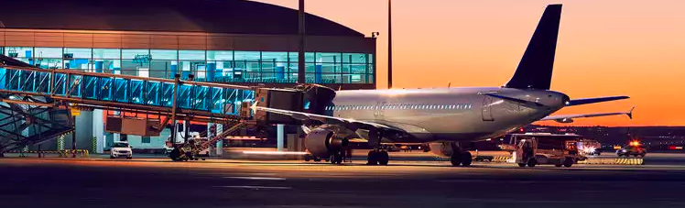
Outline
Topic
Clients & Goals
ERD
Business Rules
Sample Tables
Queries: Trigger, Functions, Views
Report: Visualizations
Conclusion: Limitations & Next Steps, Further Extensions

Slide 3



Topic
HOW TRAVEL AGENCIES STORE AND MAINTAIN CUSTOMERS’ INFORMATION?
HOW THESE AGENCIES USE FLIGHTS INFORMATION?
HOW DATABASE HELP THEM SUCCESS?

Slide 4

Clients & Goals
Provide both small airlines and big airlines equal opportunities to sell their tickets.
Allow marketing staff to negotiate with airlines about more economical prices and cooperation
Fully use resources to maximize profit for partnered airlines.
Supply insight to give appropriated advertise for targeted marketing.
Provide information for sales and marketing staff to analyze and design the promotion for customers

Slide 5

ERD

Slide 6
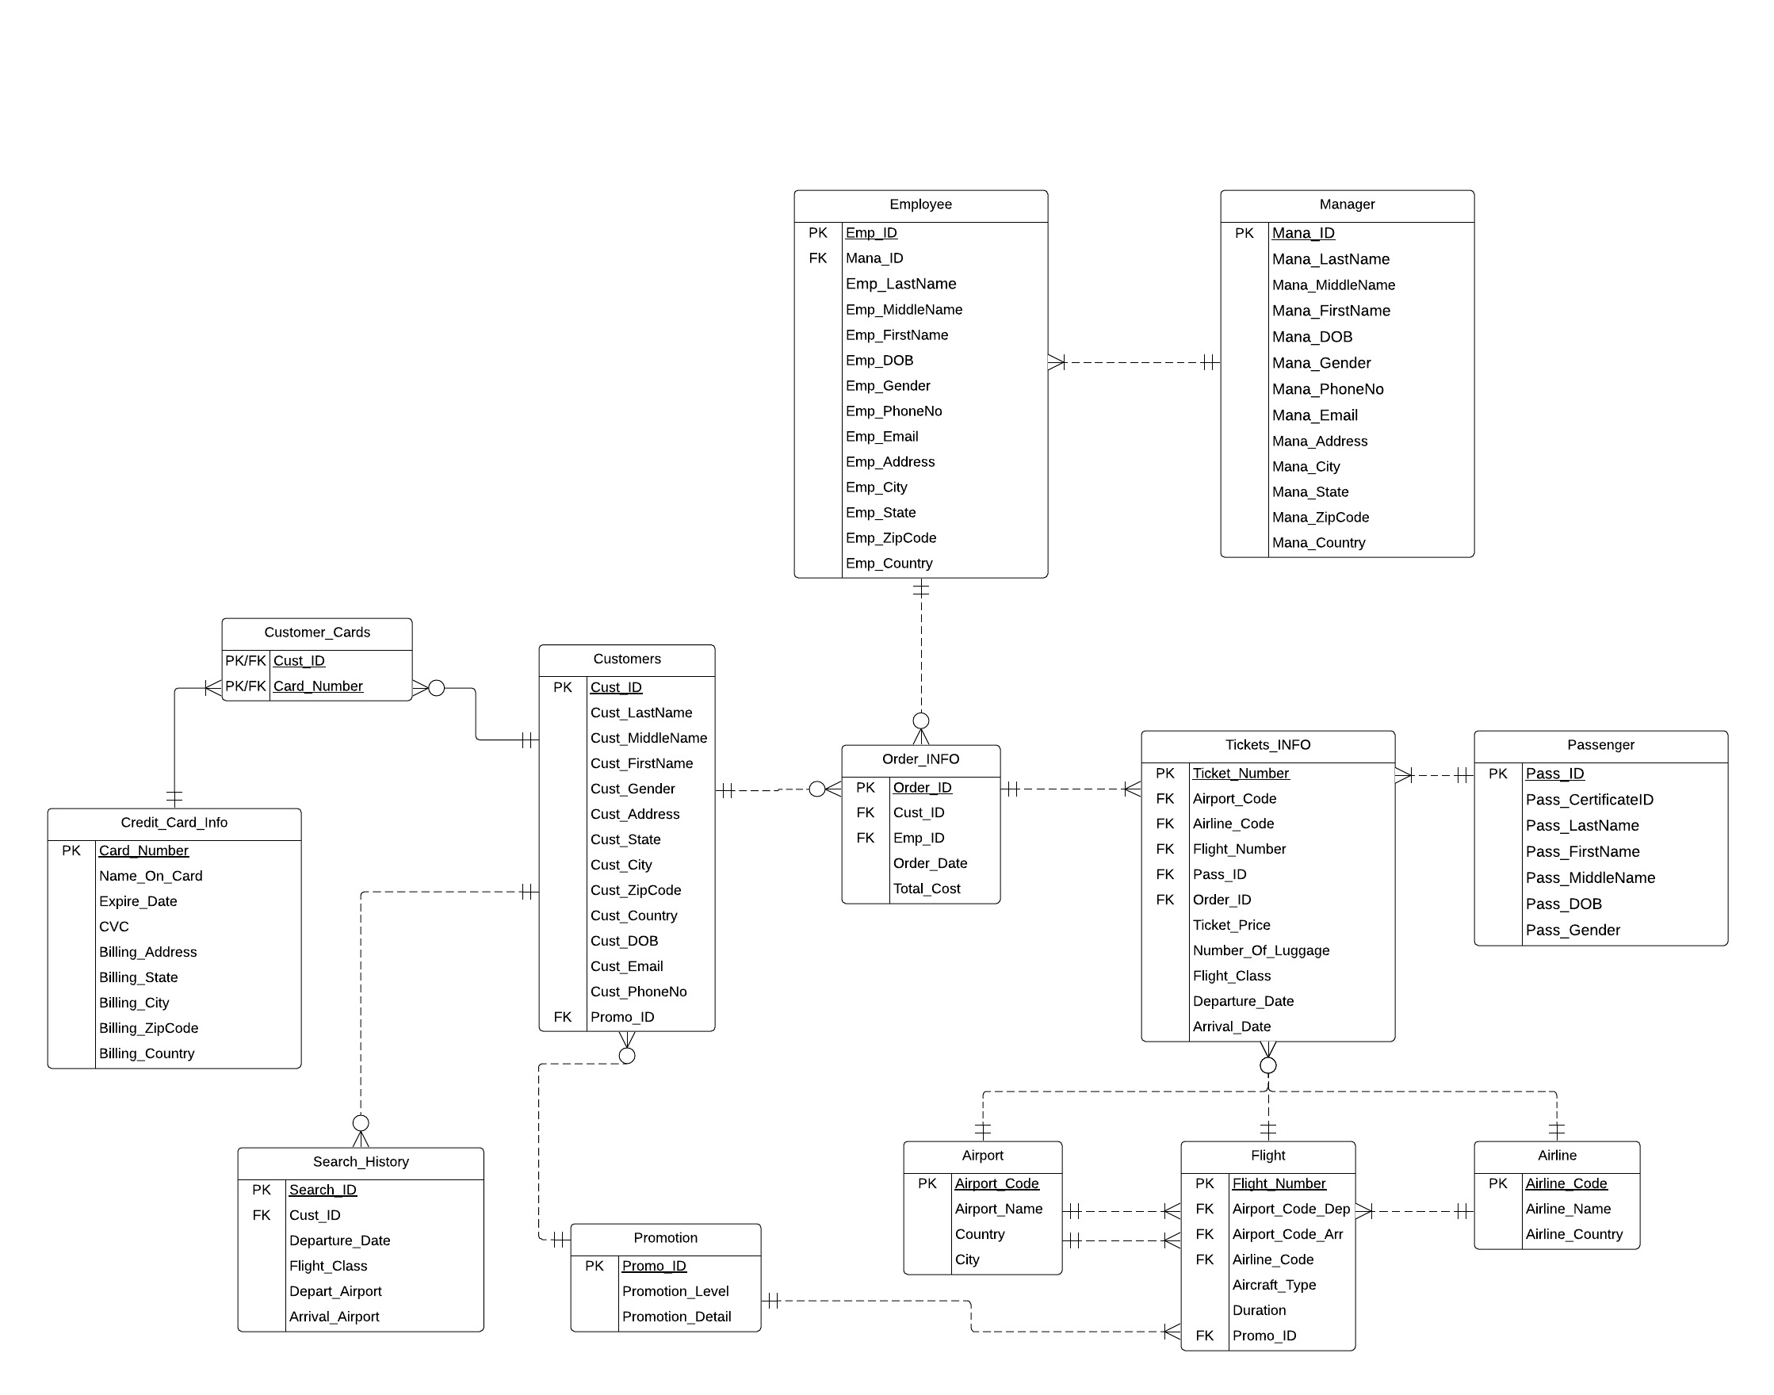
ERD

Slide 7
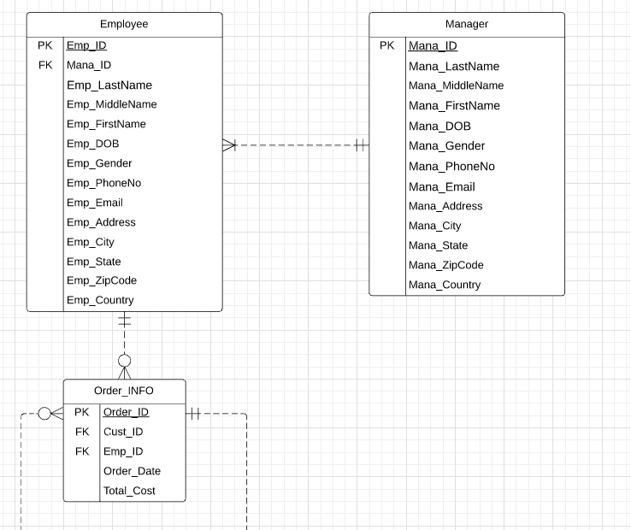

Slide 8
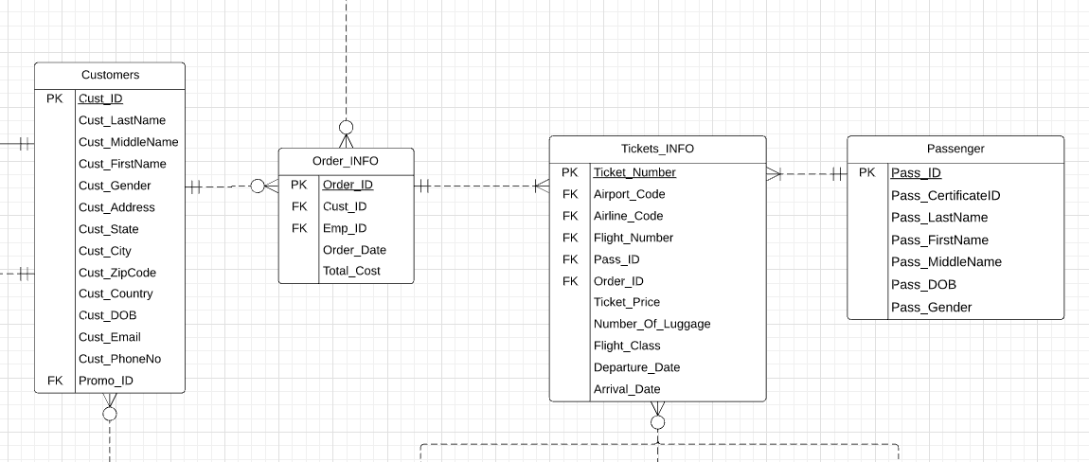

Slide 9
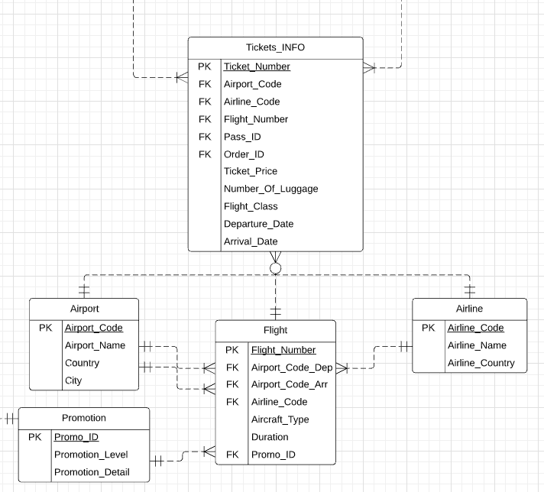

Slide 10
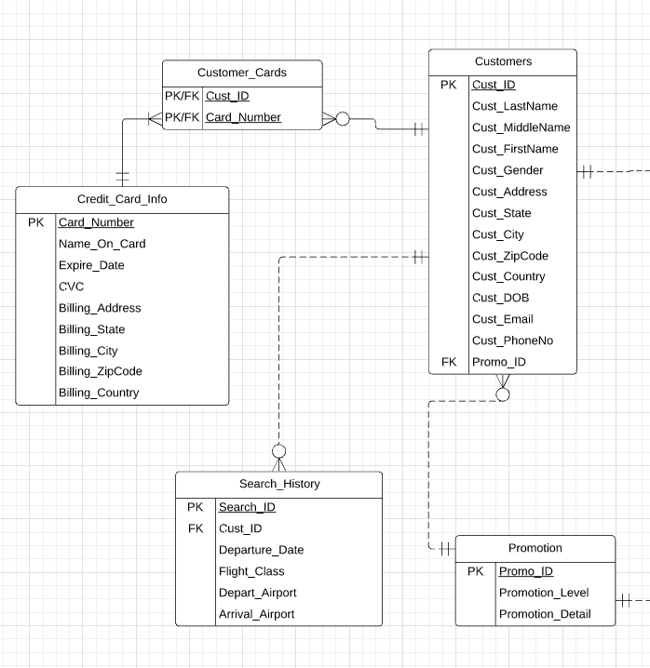

Slide 11

Business Rules
● Each customer may have zero or more orders.
● Each order must have one or more tickets.
● Each passenger must have one or more tickets.
● Each ticket can only have one passenger.
● Each employee can handle zero or more orders.
● Each manager may have one or more employees.
● Each customer has only one promotion level.
● Each customer may have zero or more credit cards.
● Each credit card must associate with one or more customer.
● Each ticket have only one airport.
● Each ticket have only one airline.
● Each ticket have only one flight.

Slide 12
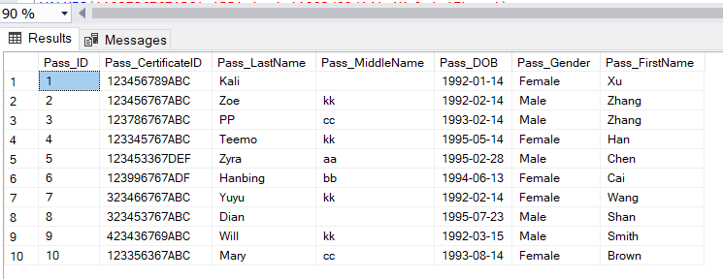
Sample Table

Slide 13

Queries

Slide 14
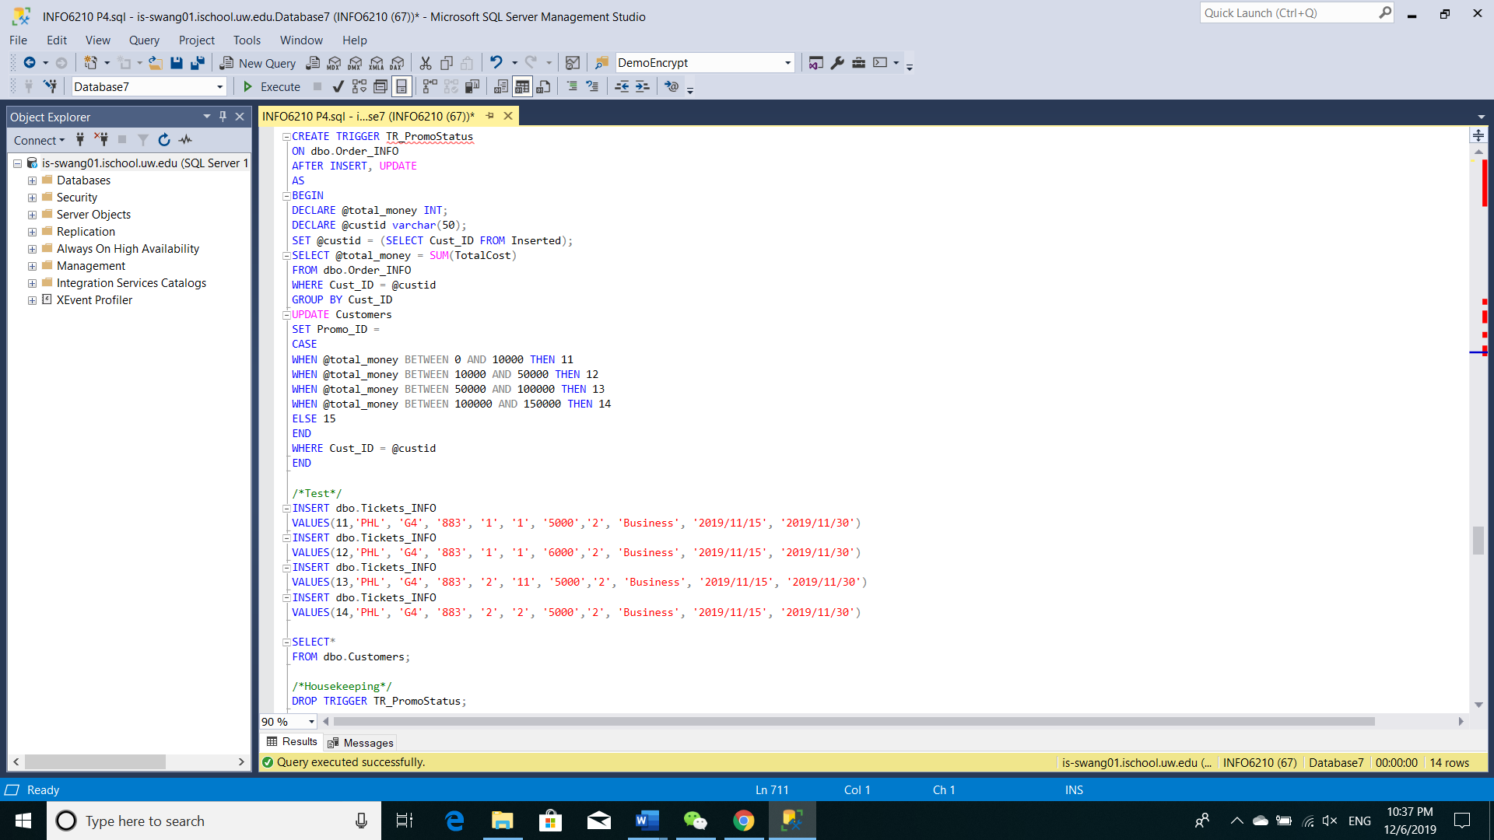
Trigger
Trigger
To check and update the promotion level of customer

Slide 15
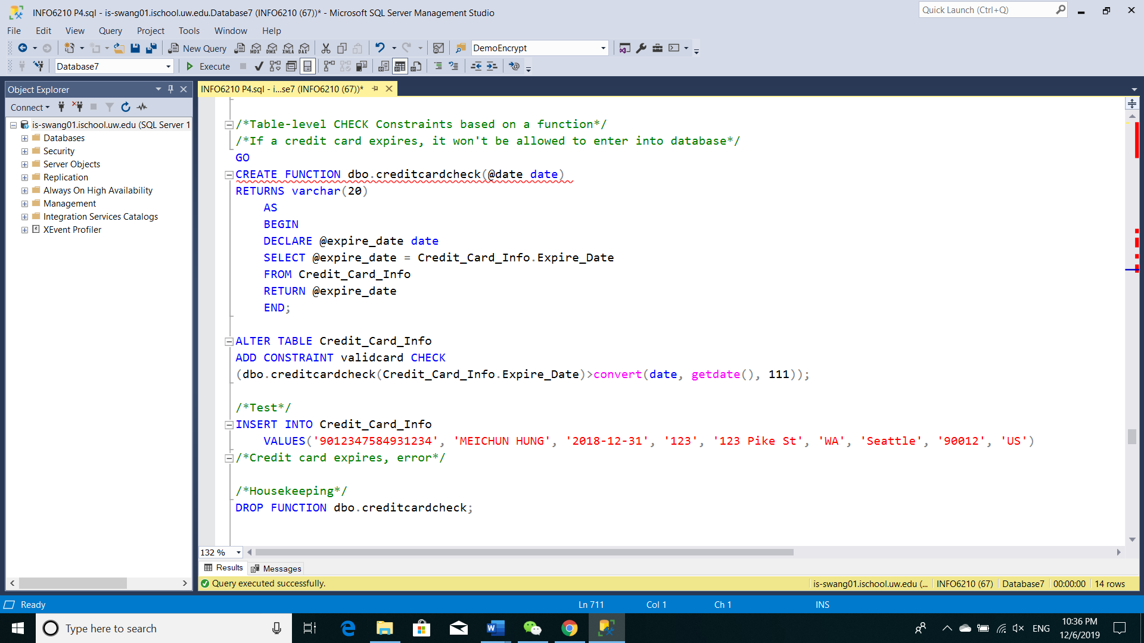
Table-Level Constraint Check
To check if the credit card is valid

Slide 16
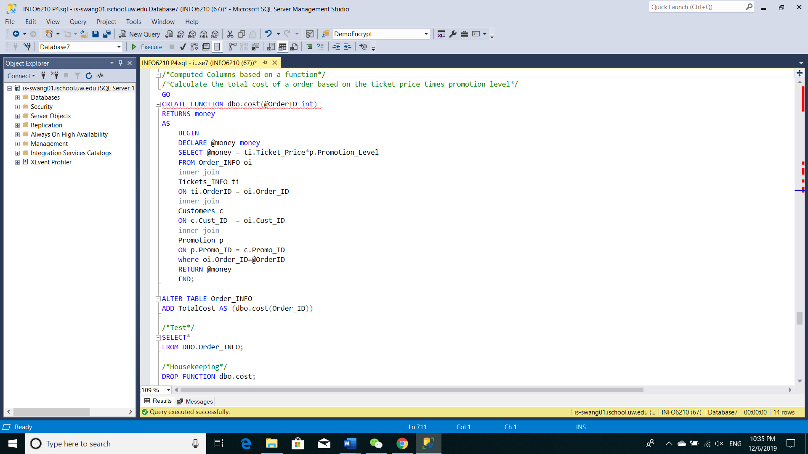
Functions
Function for Computed Column
To calculate the total cost of order

Slide 17
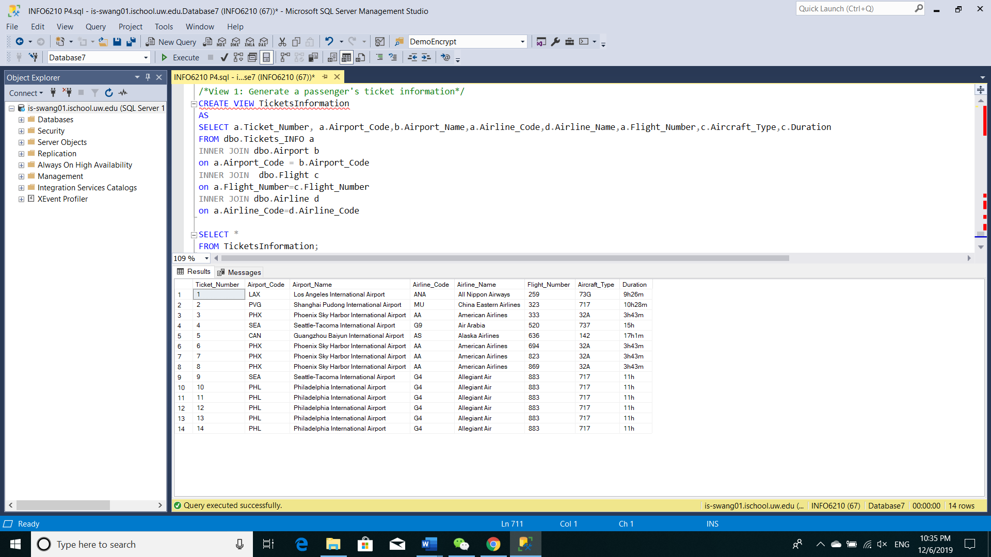
View 1
View for Ticket Information

Slide 18
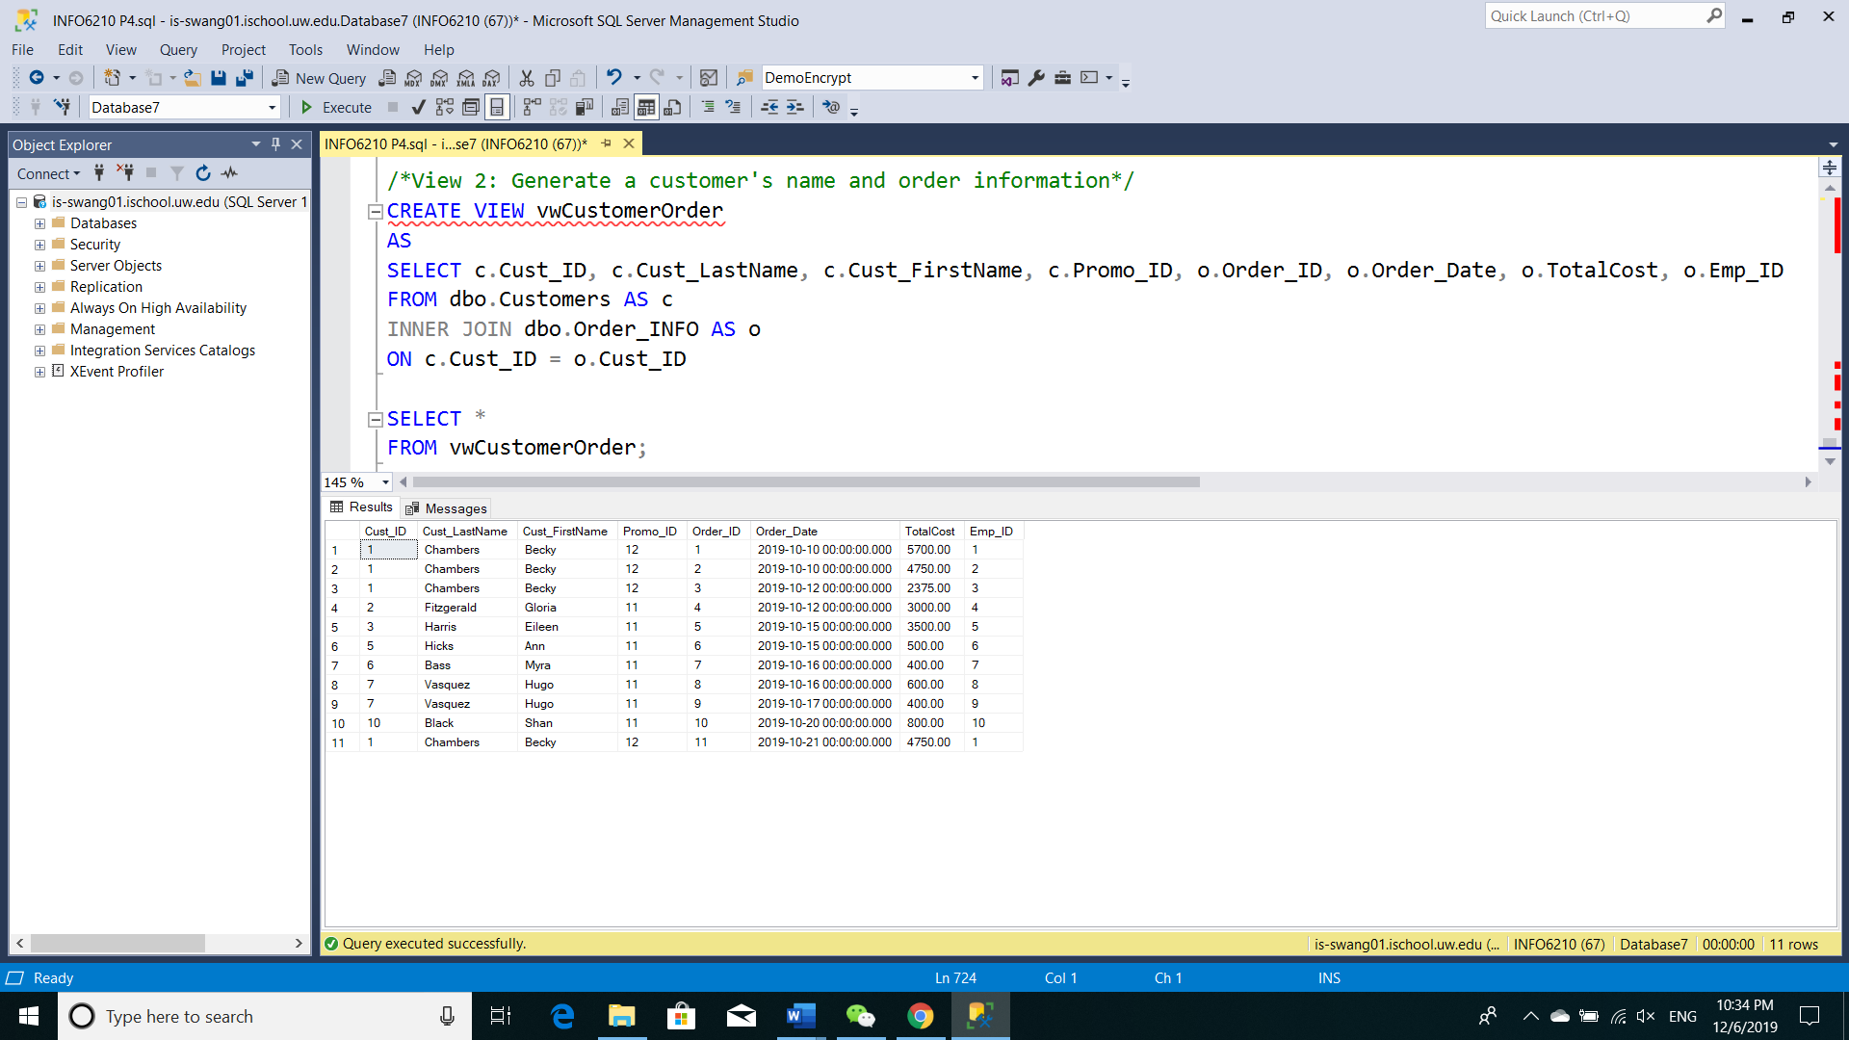
View for Customer and Order

Slide 19

Report

Slide 20
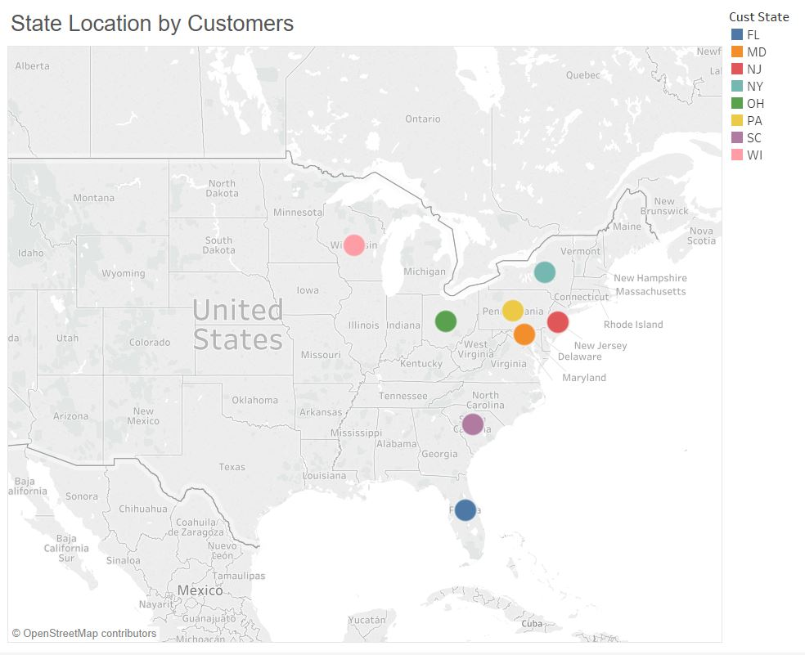

Slide 21
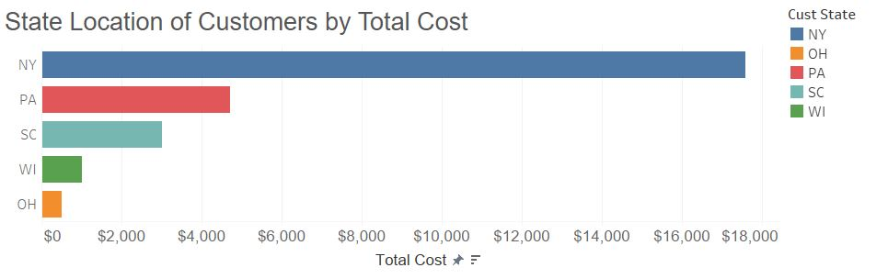
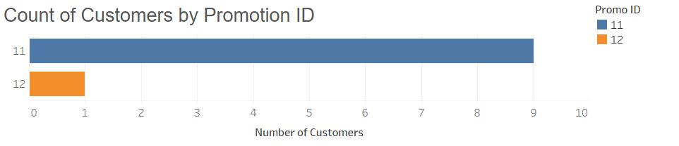

Slide 22
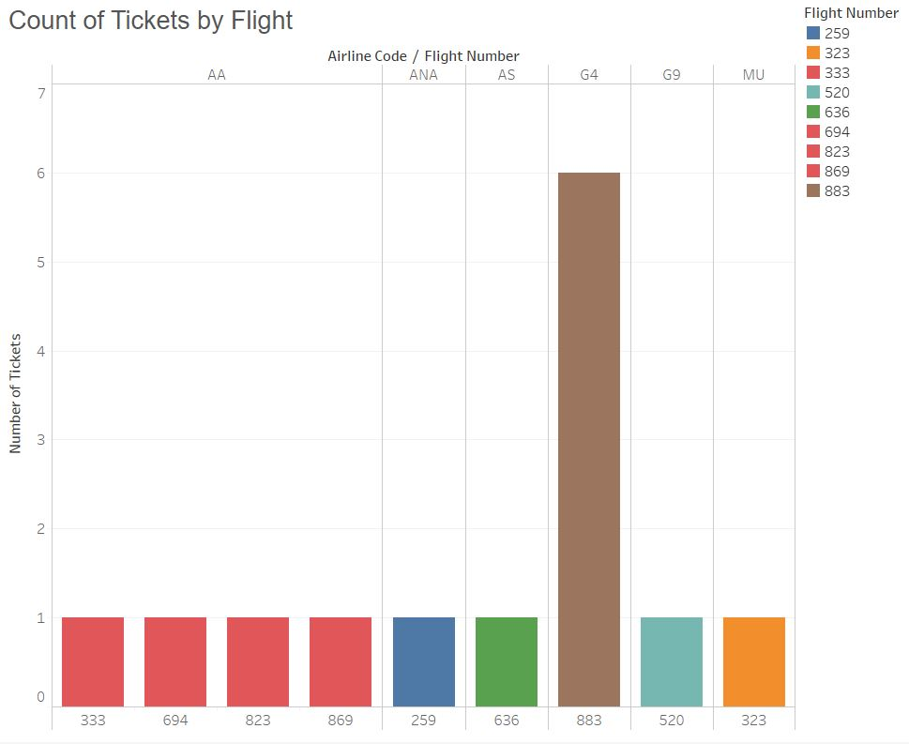

Slide 23
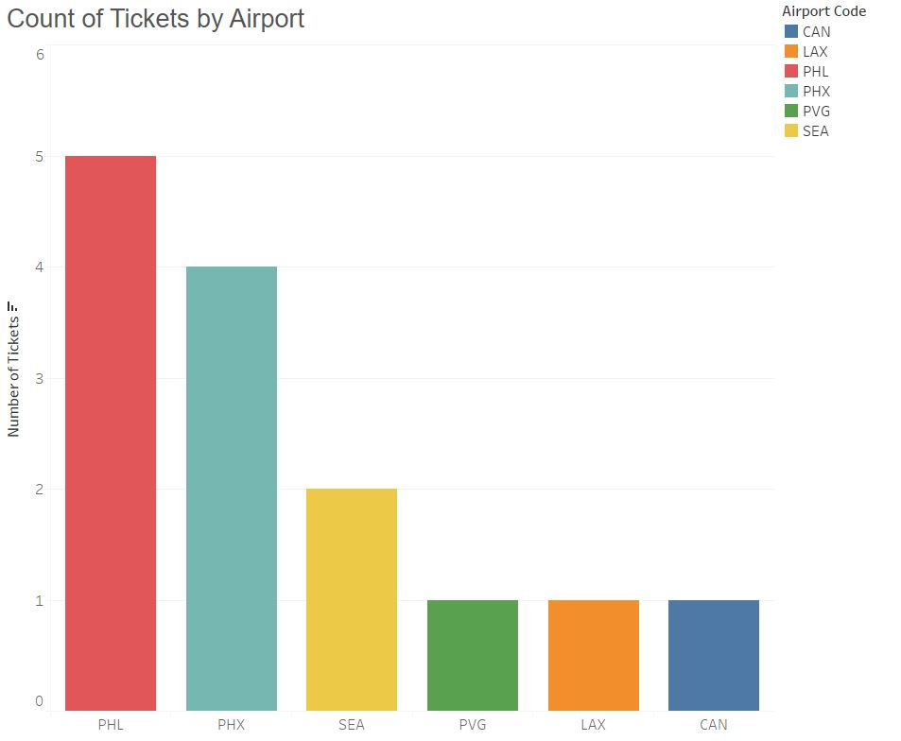

Slide 24


Slide 25

Limitations & Next Steps
Adding diversified promotions in Promotion table
Passenger table: adding table level constraints to stop inserting if necessary
FK Promotion ID in Flight was not used
Adding functions/stored procedures for marketing

Slide 26

Further Extensions
Collaborate with Airline websites.
Expanding business: adding more tables like Hotel, Rental Cars.
More functions: vacation packages.

Slide 27
